Slide 1
Machine Learning: Specialization in Deep Learning
Presented by – Swati Kanchan & Lokesh Nandanwar

Slide 2
Overview
ML Basics
Why Machine Learning?
Learning categories
Classification
Clustering
Regression
Neural Network
What is Neural Network?
Analogy with brain
Why Deep Learning?
Logistic Regression as Neural Network
Logistic Regression
Binary Classification
Cost Function
Gradient Descent
Derivative

Slide 3
….Overview contined
Shallow Neural Network
Computing NN outputs
Activation Function and Derivatives
Example with Keras gradient descent
Deep Neural Network
Deep L-layer NN
Building blocks
Forward and Backward propagation
Parameter vs Hyperparameters
Example with Keras
Housing-Price problem with NN
An overview of Cat-Dog Classification

Slide 4
Machine Learning Basics

Slide 5
Arthur Samuel described it as: “the field of study that gives computers the ability to learn without being explicitly programmed.” This is an older, informal definition.
Tom Mitchell provides a more modern definition: “A computer program is said to learn from experience E with respect to some class of tasks T and performance measure P, if its performance at tasks in T, as measured by P, improves with experience E.”
Example : I will make a simple example to understand better . Imagine you have some sets of the pair of numbers. Then you put only 1 number of the pair into a machine to predict the other half of the pair. (2,4),(3,6),(4,9) . The computer program has to predict the second number for (5,?)
The program first needs to find the logic between the pairs and then apply the same logic to predict the number. To find that logic is called “machine learning”. So that after finding the logic it can apply the same logic to predict each number.

Slide 6
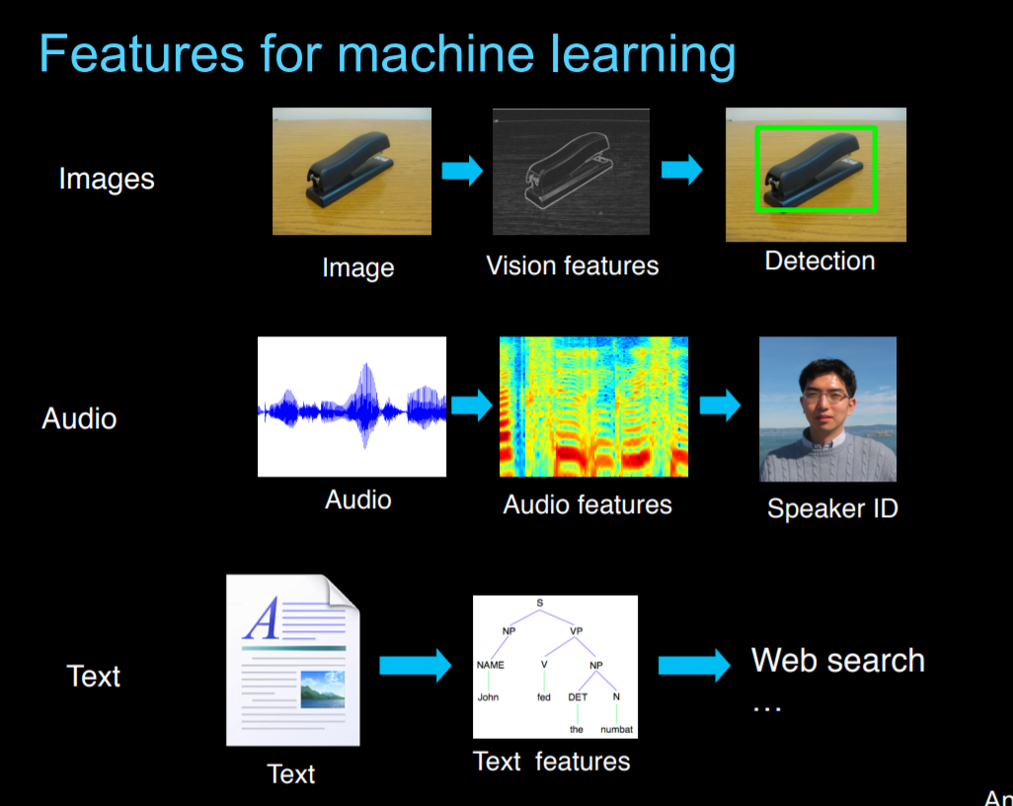
Why Machine Learning?

Slide 7
Learning categories
Supervised Learning: the correct classes of the training data are known
Unsupervised Learning: the correct classes of the training data are not known
Semi-Supervised Learning: A Mix of Supervised and Unsupervised learning
Reinforcement Learning: Allows the machine or software agent to learn its behavior based on feedback from the environment. This behavior can be learnt once and for all, or keep on adapting as time goes by.

Slide 8
Machine Learning Techniques

Slide 9
Classification
Predict class from observations
Classify a document into a predefined category.
Documents can be text, images
Example with images: a cat-dog classifier

Slide 10
Clustering
group observations into “meaningful” groups
clustering is the task of grouping a set of objects in such a way that objects in the same group (called a cluster) are more similar to each other.
For e.g. these keywords
– “man’s shoe”
– “women’s shoe”
– “women’s t-shirt”
– “man’s t-shirt”
– can be cluster into 2 categories “shoe” and “t-shirt” or
“man” and “women”
Popular ones are K-means clustering and Hierarchical clustering

Slide 11
Regression
predict value from observations
is a measure of the relation between the mean value of one variable (e.g. output) and corresponding values of other variables (e.g. time and cost).
regression analysis is a statistical process for estimating the relationships among variables.
Regression means to predict the output value using training data.
Popular one is Logistic regression (binary regression)

Slide 12
Neural Networks

Slide 13
What is Neural Network?
It is a powerful learning algorithm inspired by how the brain works.
The idea:
Build learning algorithms that mimic the brain.
Most of human intelligence may be due to one learning algorithm.

Slide 14
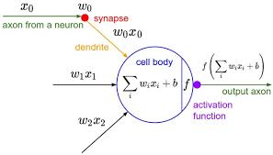
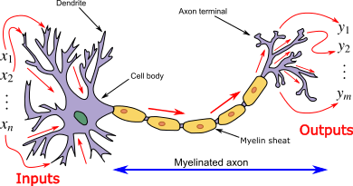
Analogy with Brain:

Slide 15
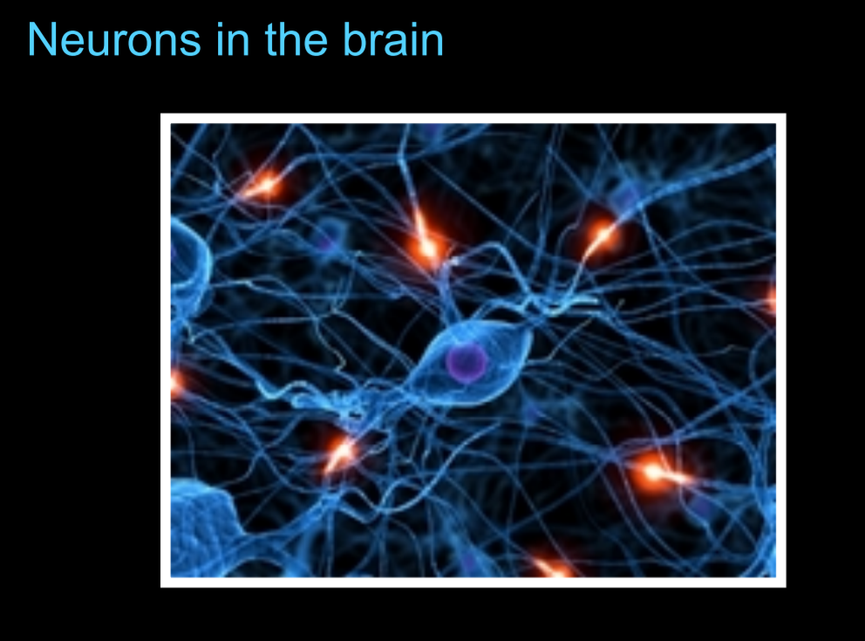
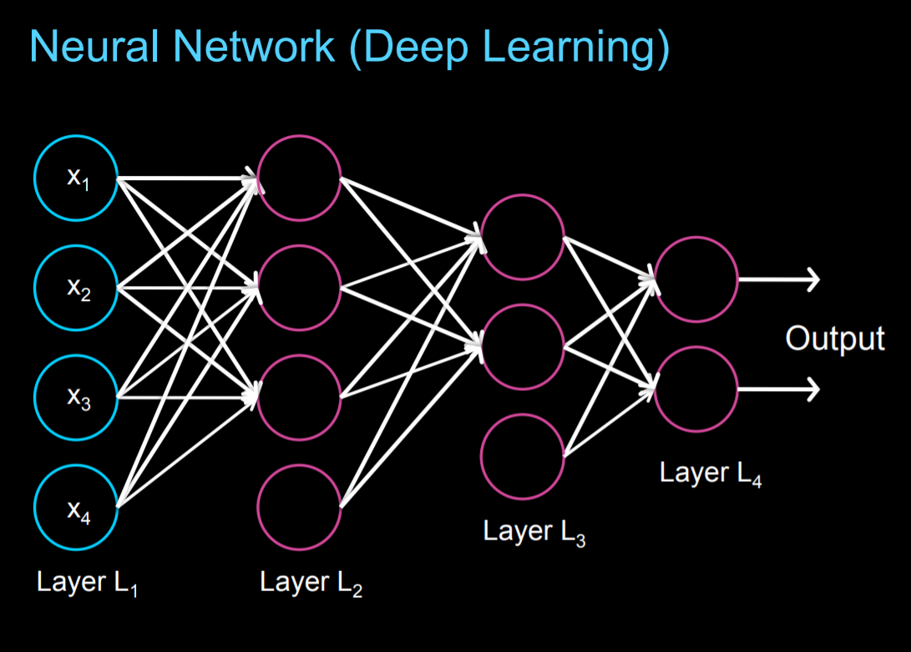

Slide 16
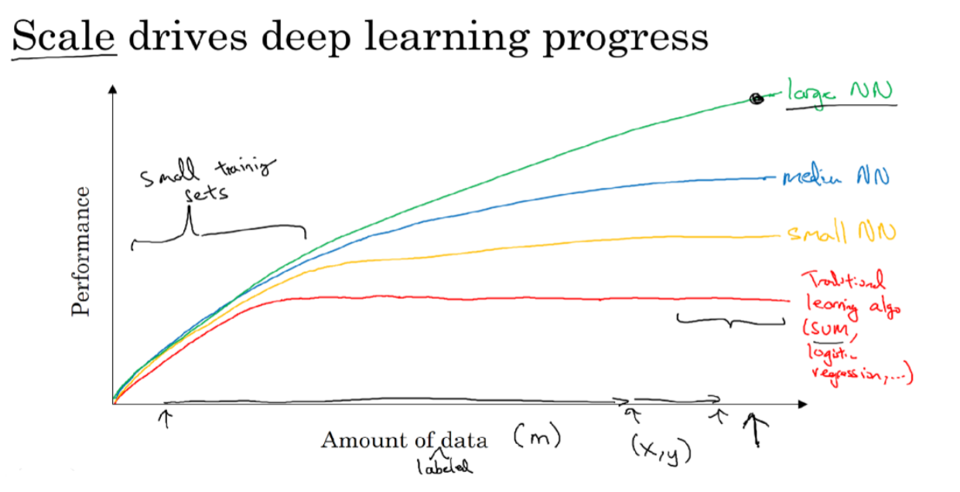
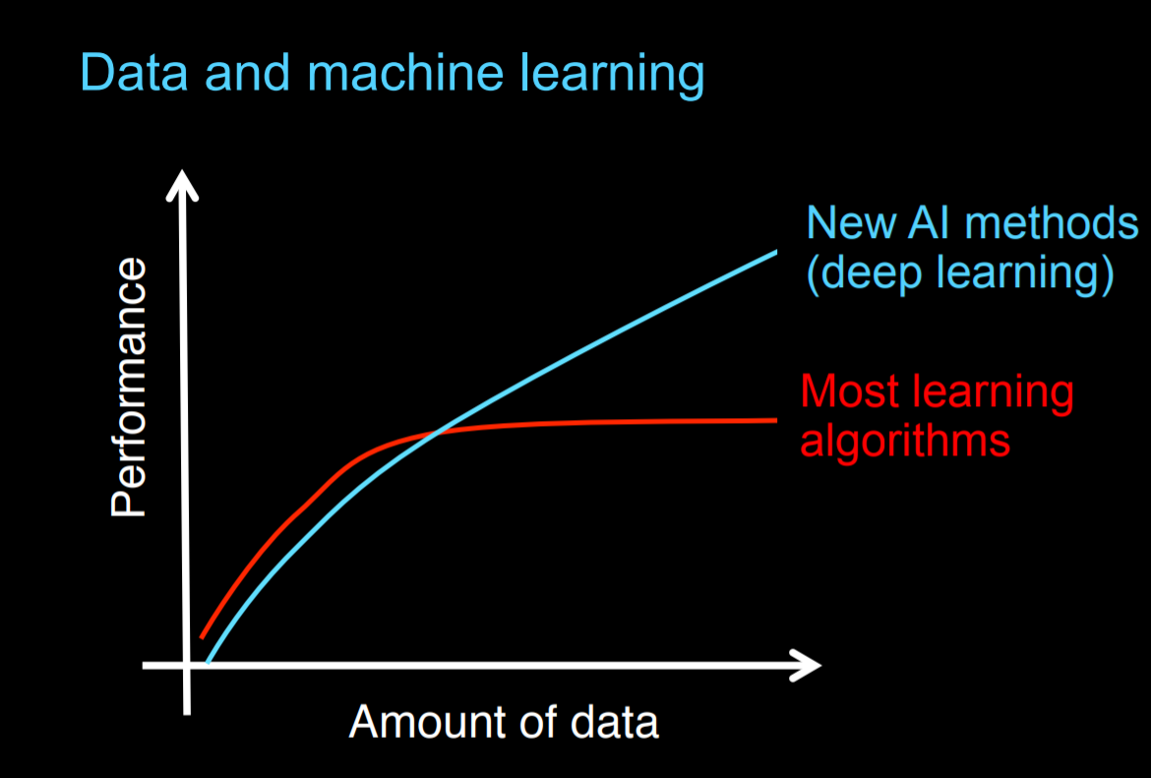
Why Deep Learning?

Slide 17
Why Deep Learning?....continued
Deep learning is taking off due to a large amount of data available through the digitization of the society, faster computation and innovation in the development of neural network algorithm.
Two things have to be considered to get to the high level of performance:
1. Being able to train a big enough neural network (GPUs come to rescue!)
2. Huge amount of labeled data
The process of training a neural network is iterative.
Idea -> Experiment -> Code

Slide 18
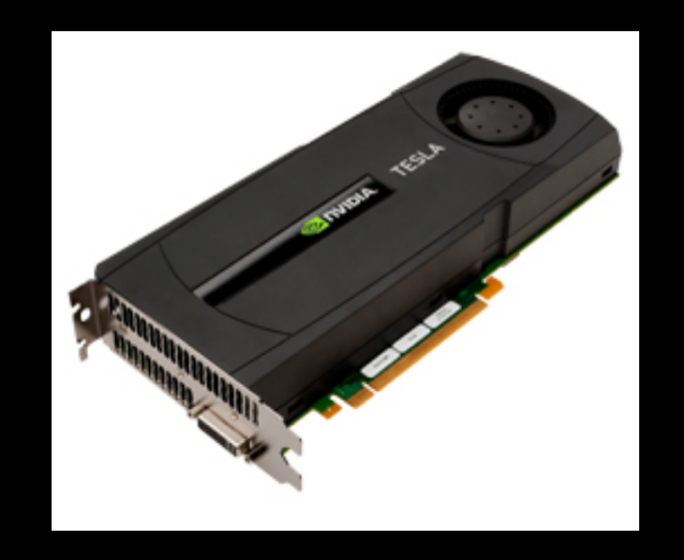
Why need GPUs?
It could take a good amount of time to train a neural network, which affects your productivity. Faster computation helps to iterate and improve new algorithm. This can only be achieved by using GPUs.

Slide 19
About Train, Validation and Test Sets in Machine Learning
Training Dataset: The sample of data used to fit the model.
The actual dataset that we use to train the model (weights and biases in the case of Neural Network). The model sees and learns from this data.
Validation Dataset: The sample of data used to provide an unbiased evaluation of a model fit on the training dataset while tuning model hyperparameters. The evaluation becomes more biased as skill on the validation dataset is incorporated into the model configuration.
Test Dataset: The sample of data used to provide an unbiased evaluation of a final model fit on the training dataset.

Slide 20
Parameters Vs Hyperparameters
Parameters are the properties of the training data that are learnt during training by the classifier or other ml model. For example in case of some NLP task: word frequency, sentence length, noun or verb distribution per sentence, the number of specific character n-grams per word, lexical diversity, etc. Model parameters differ for each experiment and depend on the type of data and task at hand.
Hyperparameters, cannot be learnt during training but are set beforehand. A typical set of hyperparameters for NN include the number and size of the hidden layers, weight initialization scheme, learning rate and its decay, dropout and gradient clipping threshold, etc.

Slide 21
Logistic Regression…to be continued

